Slide 1
Some Observations About the Near Future of Alternative Computing Technology
Bob Colwell
February, 2018
NICE 2018
Hillsboro, OR

Slide 2
Disclaimers
Things I don’t know much about
I don’t know much about Machine Learning
I am no expert on neuro-inspired stuff
I still struggle with Bayesian inference no matter how many times Dan Hammerstrom has explained it to me*
Things I might know something about
Lessons from the computer industry’s past
Opportunities post-Moore’s-Law
Product family planning
*my fault, not his

Slide 3
What does NICE success look like?
Think in terms of adding value, not World Domination
World doesn’t need nor want better spreadsheet, Word, Outlook, Powerpoint engines
But they do want reliable, cheap, engines for those kinds of apps
Conventional digital CMOS is already good enough for lots of things
Protocol FSM’s, device controllers, communications, embedded control
Can’t dislodge the incumbent by barely beating it
Would have to win by very large margin across board (probabilistic technologies need not apply)
…or…
Make something important feasible that was not before
NICE is going to have to learn to play nice with incumbent tech
Accelerators
Add-on facilities for servers
Add-on tech for conventional SoC’s
Match market economics
NICE tech is not standalone. For volume, the infrastructure it will get is what we already have in place.

Slide 4
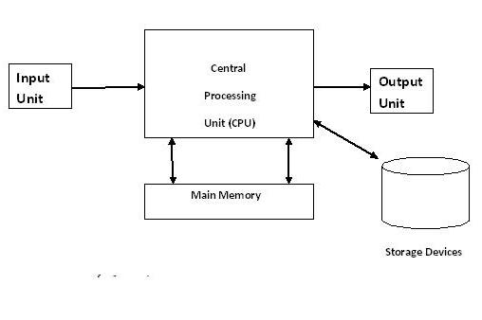
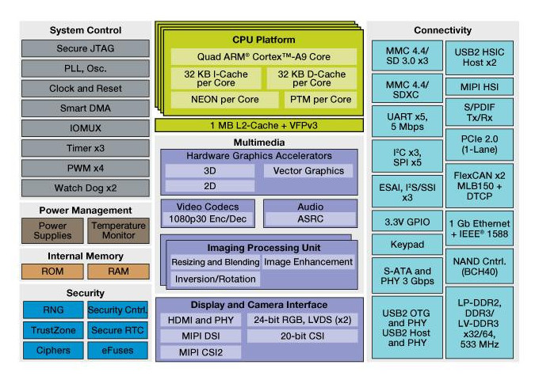
Heterogeneous Circus
Today
The Good Old Days
You will be adding to this hodge podge
It is easy to design things that cannot be effectively programmed.

Slide 5
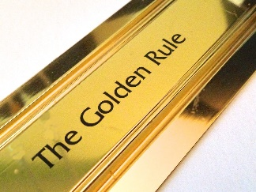
What can we learn from computing history?
General-purpose computing ruled for
decades because of golden rule:
Better perf on existing code + new apps & OS’s = $$Profits
Why did that formula work?
CPU perf/features got exponentially & predictably better over time
OS’s/SW got better (and demanded better CPU’s)
Platform improvements did not choke (PCI, QPI, USB, DRAM, buses, caches…)
Overall system cost fell drastically due to huge unit volumes
Security issues have remained annoyances, not limiters
There was a predictable future safeguarding today’s investments
Can we just re-apply that formula with NICE technology?

Slide 6
Does the golden rule apply to NICE tech?
CPU perf/features got exponentially & predictably better over time
CPU perf has stalled, and GPU perf will too, due to thermals.
NICE-accelerators will improve for a few years but Moore’s Law is still dead
OS’s/SW got better (and demanded better CPU’s)
New SW will take advantage of new NICE accelerators BUT
Our ability to program heterogeneous accelerators is poor
What are the apps? Those are what drives demand, not “capability” per se
Platform improvements did not choke (PCI, QPI, USB, DRAM, buses, caches…)
Still some room for improvement here
But DRAM is dying, system economics worsening
Overall system cost fell drastically due to huge unit volumes
Smartphone volumes are reaching saturation
IoT volumes will dwarf smartphone, but there’s no profit there
Must get the app/NICE/algorithm choir singing nicely

Slide 7
Efficiency is NICE’s friend
General computing largely ignored efficiency
MPEG-2 HW decoder 1000x > software decoder on CPU
Tasks that are too much for CPU’s may be feasible with accelerators
End of Moore’s Law means you can no longer just wait around and faster machines will appear…only accelerators will enable certain classes of new apps
What new apps? Dunno. Historically, we never knew until they appeared
Various forms of machine learning appear to be likely. What else?
Accelerator designers may have to predict these new apps
Building a special-purpose machine for the wrong algorithm is a Really Bad Idea*
1000x was don’t-care when CPU power low
Efficiency became 1st order concern in 2004 when sys thermals hit air-cooling limit
Industry’s answer: multicore
Kept the arch franchise going but w/o the customary perf kick
NICE no longer needs 1000x to play: CPU’s/GPU’s becoming stationary targets. WILL YOU?
*courtesy Rich Lethin / Reservoir

Slide 8
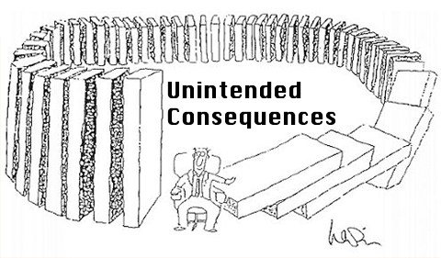
Other things NICE must get right
Switch away from historic “design to be correct” to “design knowing there will be emergent behavior” and algorithmic errors/misuse
Emergent behavior is never in your favor
It arises from system complexity
The same system complexity that keeps most humans from understanding how the system really works or why it does what it does
There will be unintended “communications paths” in the systems you sell into
Spectre/Meltdown
RowHammer
EMI, RFI, gnd/VCC coupling, intentional mistreatment by hackers

Slide 9
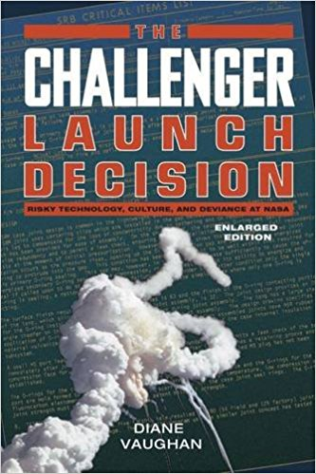
And there will be failures
Historical failures remain: Software
SW races, resource sharing errors, driver problems, inability to test all combos
Heterogeneous systems are coded “by hand”…source of errors
We don’t check reasonableness, we don’t usually “contain” error sources
Historical failures remain: Hardware
Shrinking system error margins
Shared power/gnd, gnd bounce, metastability
Systems routinely near thermal limits
Relying on convergence (training) to fix transients
No error-checking on inferences
You must judiciously provide backup plans
But don’t make usual error of treating them less seriously than main plan
Thinking you have a backup, when you actually don’t, is worse than having none
(See NASA Space Shuttle Challenger accident)

Slide 10
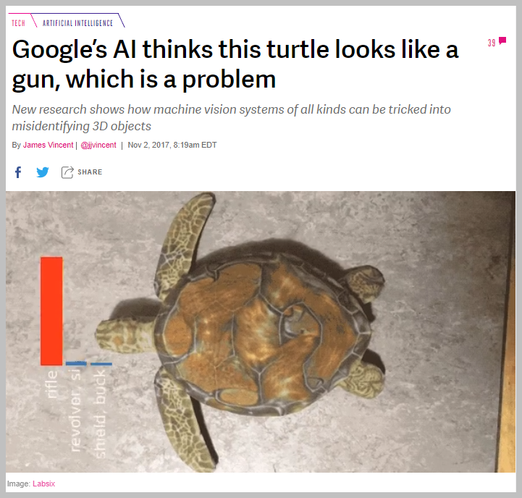
And a new class of errors unique to NICE accelerators
https://www.theverge.com/2017/11/2/16597276/google-ai-image-attacks-adversarial-turtle-rifle-3d-printed
Systems not designed to algorithmic limitations
Can’t figure out why system errs or that it is erring
Don’t know how to include higher-level executive check before NICE use
And if a given system learns, it’s even harder to know what it will do
Users will not know where tech limits are, nor what to do about them. This is YOUR responsibility!

Slide 11
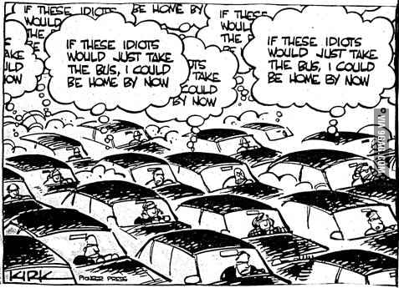
You must also get “usual” engineering details right
“Tragedy of the Commons” paths
aka shared resources
Power supply, ground returns, EMI
Thermals
Security-related behavior
Manage these despite inevitable design errata
Can’t even assume errata has no common mode!
Thermals is the one I worry about most
Each hetero agent uses supply current, generates ground return current, & contributes to overall thermal load
SoC constitutes a closed-loop control system
Workload-related activity causes various hetero agents to heat up SoC
Variable cooling system drives temp back down
How to manage each agent & whole system to best perf?
How to manage to any guaranteed minimum performance?
How to prove whole thing is stable (no “poles in the right half plane”)
It’s the unwanted unit-interactions that will really get you

Slide 12
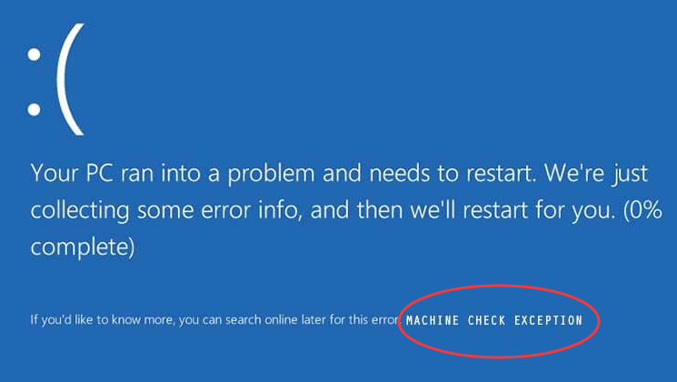
What about “machine check?”
After 40 years we have no standards in this area
We don’t systematically check machine ops nor results for correctness
We don’t have uniform means of constraining errors from propagating once they manifest…debug is hard and will get much harder
The heterogeneous future is inheriting an ad hoc, crazy quilt of
What’s easy to measure (parity on ROMs, illegal FSM states, protocol errors)
Necessary to monitor (DRAM errors, cache errors, bus xfers)
Program errors (FP exceptions, illegal accesses)
Temperature & Volts (over/under)
What do we really want?
Confirmation of correct answers?
Trending towards marginality indicator to stimulate preventive maintenance?
Health-of-the-machine indicator?
AutoRecovery from certain errors? AutoRecovery from all errors? (good luck!)
Small % error likelihood x large number of trials = Big Problem
Neither science nor engineering has really been applied here
Our Machine-Check past shows what NOT to do

Slide 13
Standards are your friends
Industry standards for hetero design will be crucial for hitting short
time-to-market for all future systems. A “rising tide” will save you!
You should also participate in IEEE standards development so that they are fair and don’t disadvantage your product.

Slide 14
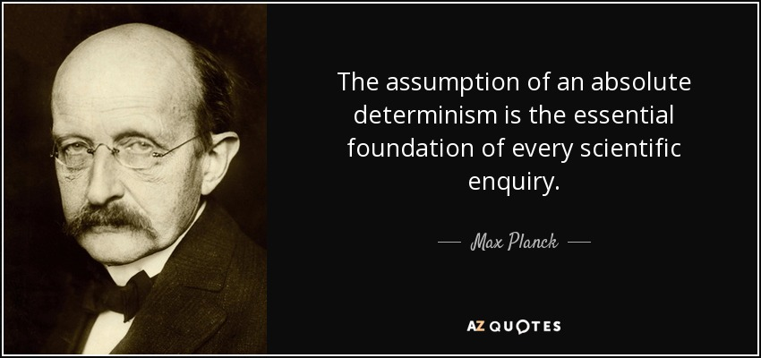
Other NICE/Heterogeneity Worries
Issues associated with simult. heterogeneity at multiple levels
Individual chips managing own thermals, Vdd, sleep conditions in large system which is doing similar things at higher levels
Reproducibility and deterministic behavior are both at risk here
All accelerators must play nicely together. This does not come for free.
Getting your new machine learning widget designed into a high-volume product is not the end game. It’s only the opening move.
Must follow with constant stream of improvements despite no Moore’s Law
Listen very carefully to initial users and your customer
Always be aware that they don’t really want you on their platform
If they can achieve anything even close to what your NICE widget provides, you’re out
You have to improve faster than they do to force them to keep outsourcing to you

Slide 15
And in conclusion…
Get the performance you need to force your NICE tech onto platform
Realize that’s only the beginning: you’ve now awoken the sleeping giant
Do defensive design, allow for emergent behavior, handle errors
Think about machine check architectures & your place in them
Participate in IEEE standards dev…you’ll need them
Remember where the profits come from…you need those, too!

Slide 16
Thanks for Shane Ryoo and Rich Lethin for discussions.

