Slide 1
Direct application of neuromorphic computing to numerical computing
Brad Aimone

Slide 2
Exascale is coming… but power is surging…
Supercomputers are increasingly limited by power consumption – Exascale forecasted to be ~100MW
Much of current Exascale effort is focused on low-power technologies
Challenge: Can low-power neuromorphic hardware solve the same problems for which we currently require high-performance computing?

Slide 3

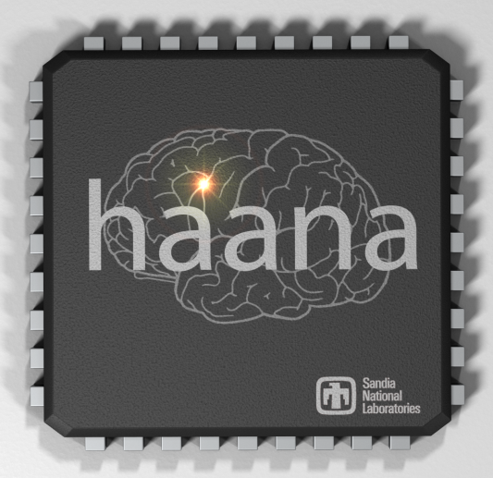
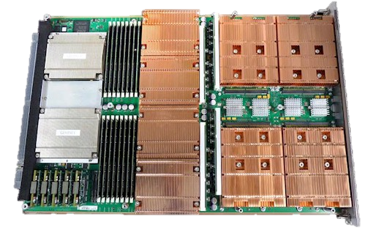
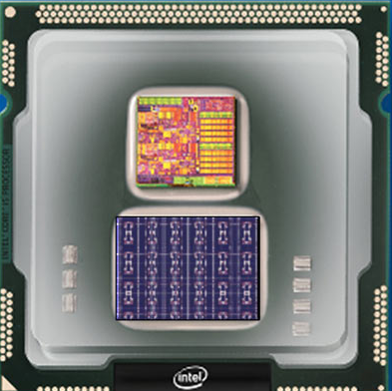
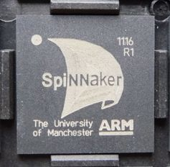
Let’s imagine fully integrated neuromorphic onto HPC platforms (sitting next to GPUs and CPUs)
Emerging neuromorphic chips
Ultra-low power spiking circuits
Scalable architecture -> easy to achieve millions of neurons

Slide 4


Machine learning is the obvious starting point…
Machine Learning / Deep Learning
Integrate Data-centric ML with scientific computing (adaptive meshes, “smart” checkpointing, error corrections, predictive simulations, etc)
IBM is going down this path with TrueNorth
Google, Facebook, Baidu, NVidia, Nervana, numerous startups, etc…

Slide 5
... but neural platforms on HPC do not need to be limited to machine learning
Neural-implemented numerical and scientific computing
Biological-inspired neural algorithms
Machine Learning
Deep Learning

Slide 6
Can neuromorphic computing impact the core numerical computations? Can neural compete on CPU’s turf?
Neural-implemented numerical and scientific computing
Biological-inspired neural algorithms
Machine Learning
Deep Learning

Slide 7
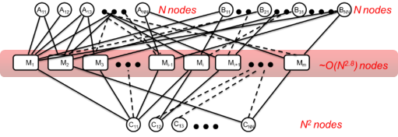
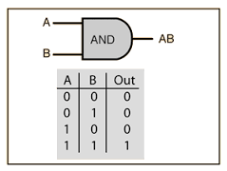
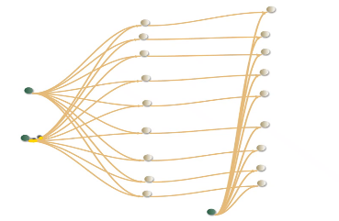
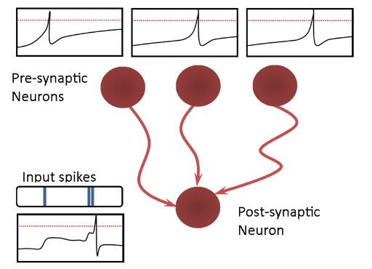
Spiking neurons in hardware are powerful logic gates… or very simple processors
Spiking threshold gates provide high degree of parallelism at very low power
Spiking neural algorithms can have clear energy benefits on numerical operations
Parekh, Phillips, James & Aimone; submitted
High fan-in
Severa, Parekh, James & Aimone; ICRC 2016
Spiking
Verzi et al., IJCNN
Verzi et al., submitted

Slide 8
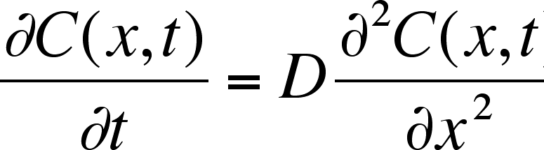
Model
Diffusion can be modeled either as a deterministic PDE or a stochastic process
  For an initial distribution of particles, P₀, what is distribution of particles at time t?
  PDE solves the following equation
  Stochastic process implements many random walkers to statistically approximate a solution
    Mean position of N walkers approaches expected mean of deterministic solution at rate of 1/sqrt(N)

Slide 9
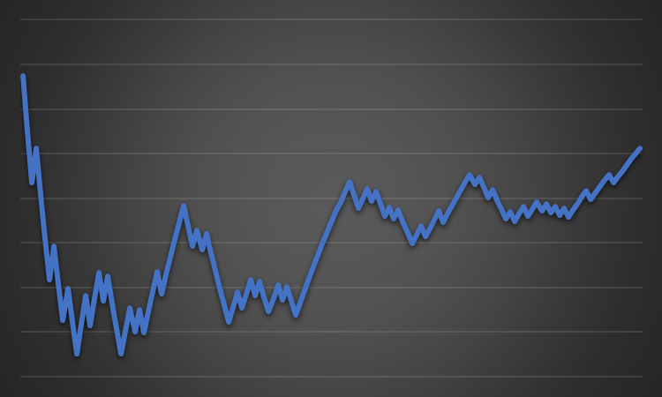
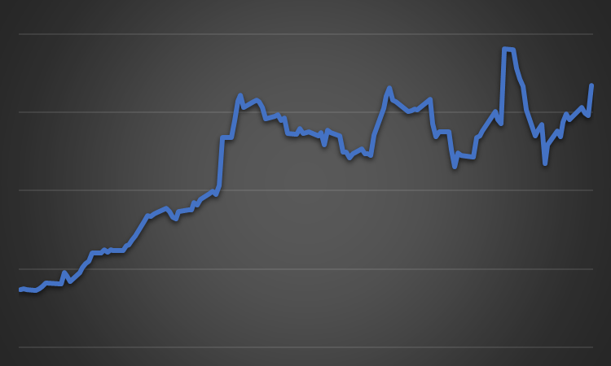
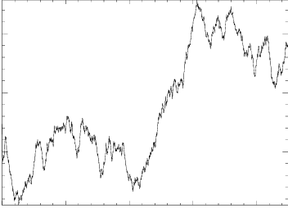
Model
Diffusion can be modeled either as a deterministic PDE or a stochastic process
  For an initial distribution of particles, P₀, what is distribution of particles at time t?
  PDE solves the following equation
  Stochastic process implements many random walkers to statistically approximate a solution
    Mean position of N walkers approaches expected mean of deterministic solution at rate of 1/sqrt(N)

Slide 10
One dimensional random walk case
p₁
p₂
Model:
  Stochastic Brownian motion
  Particle can either move or not (1-D case: probability p₁ right or p₂ left, with 1-p₁-p₂ for no move)
  Approximating PDE solutions requires sampling over MANY particles
Goal: Ensemble of neurons that represent stochastic particles, such that
  Efficient to update (randomly add / subtract value)
  Has sparse representation
  Requires few neurons
  Scalable across multiple dimensions / multiple particles
1-p₁-p₂

Slide 11
Metrics for random walk neural implementations
p₁
p₂
1-p₁-p₂
Assume k x-locations that need to be resolved, need to track over T time steps
Memory
  Position_Memory = # neurons required to differentiate k locations
  Conn_Memory = # connections required in circuit
  Neurons = Total # neurons required to operate model, including update machinery
Energy
  Position_Energy = # spikes required to represent current location
  Update_Energy = # spikes required to update location

Slide 12
Two naïve models
Binary representation of position
  Position represented by an exponential code of neurons
  Efficient storage
  Complex updates
  Having neurons implement what we typically do
Unary representation of position
  Inefficient storage
  Simple updates
  Have neurons implement something akin to place cell code

Slide 13
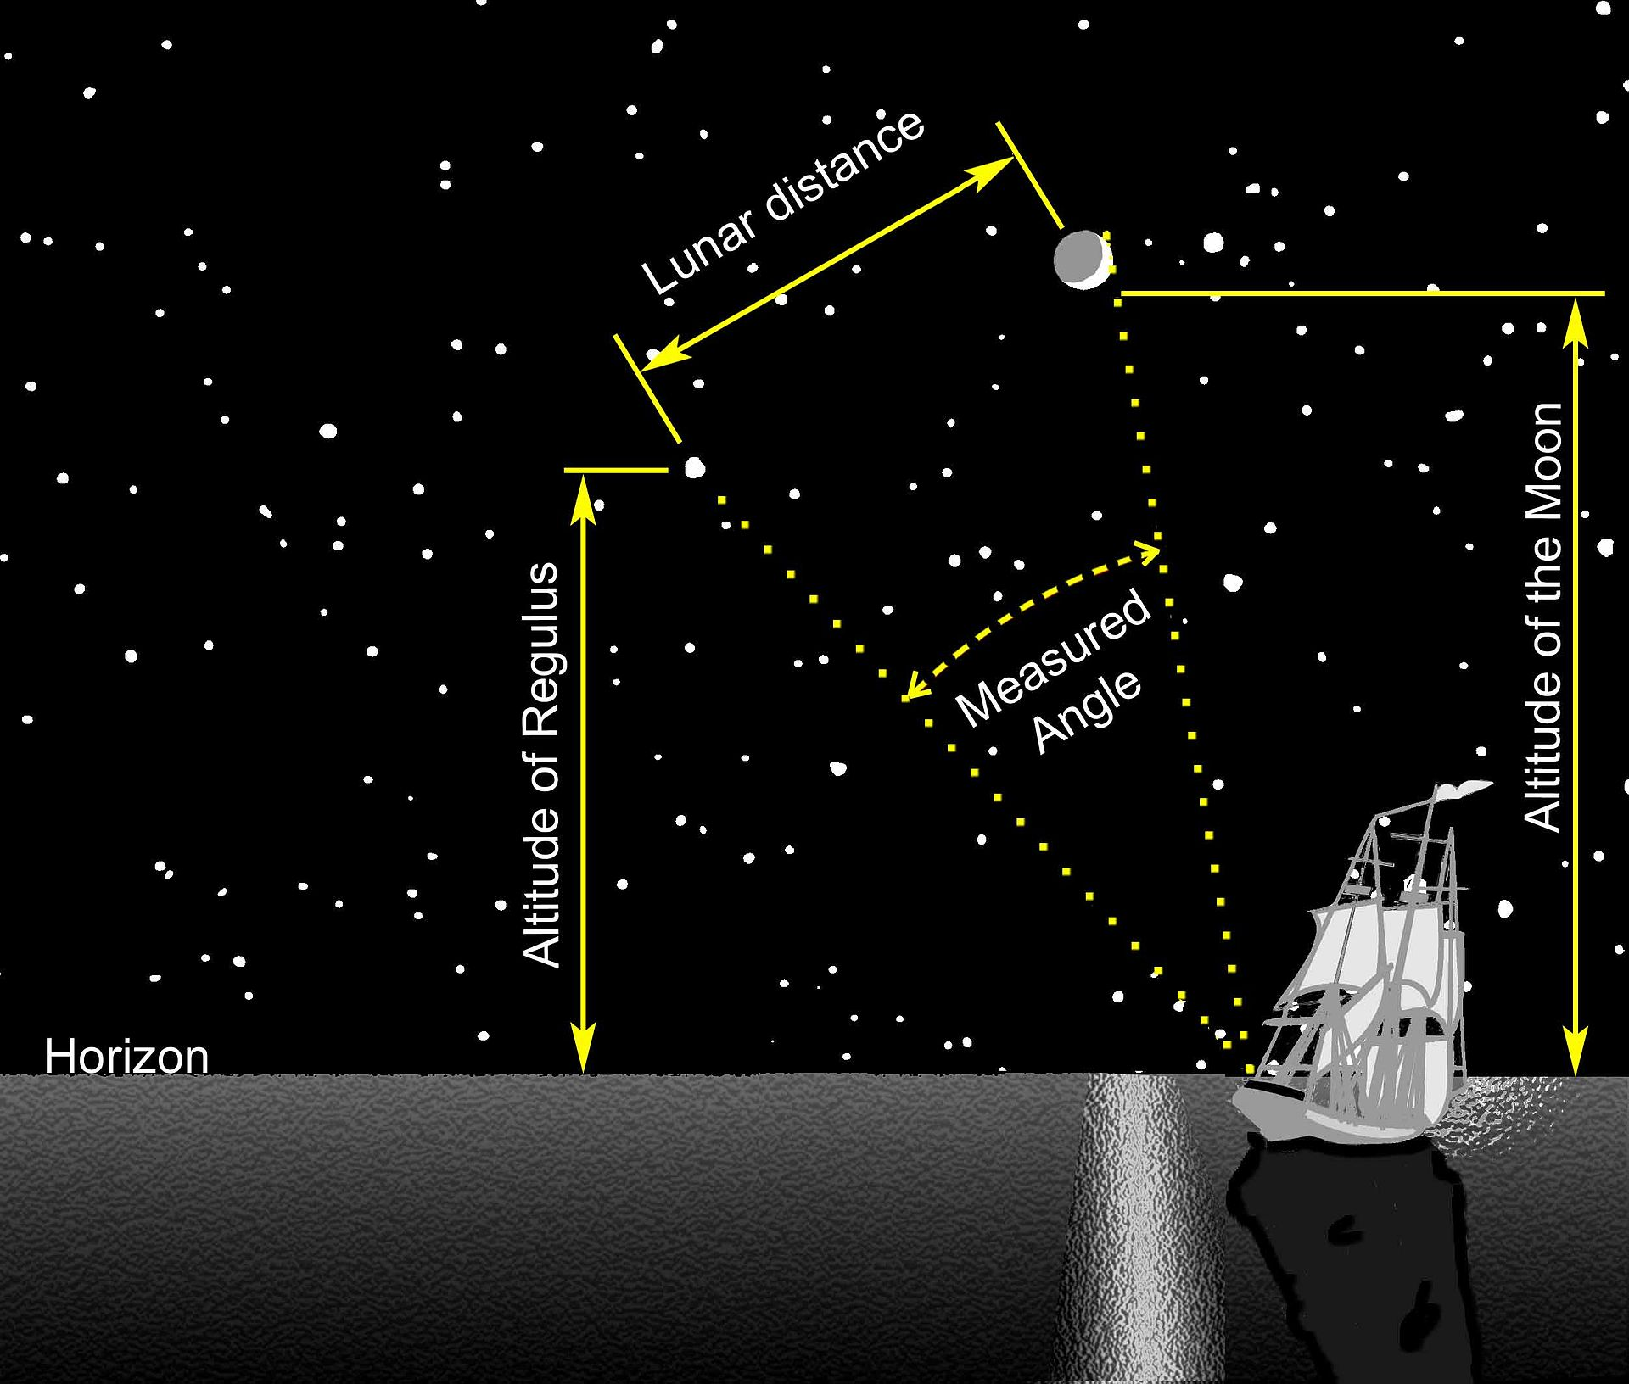
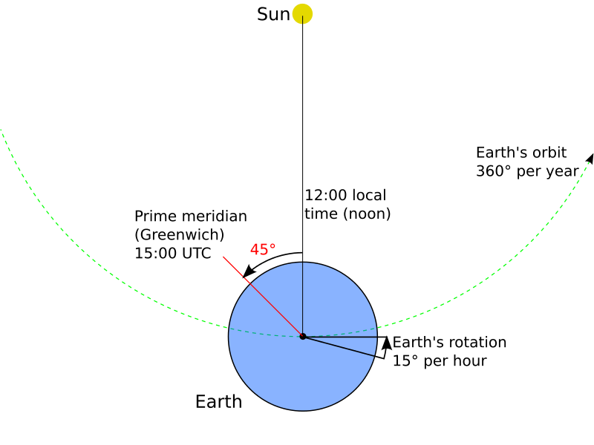
Locating a moving object is not a novel problem
In celestial navigation
  Ships could use moon and star positions to know “global” Greenwich time
  Accurate chronometer could give local time
  Comparing local time and global time provides longitude (latitude is easy)

Slide 14
Modular code gives us a “watch” to measure local position
Inspired by Fiete grid cell model and Severa counting circuit
  Take N state variables, each capable of s states, where s is a unique prime number
  Configure in a simple ring oscillator of length s
Example
  s₁=5
  s₂=7
  s₃=11
This code is capable of Π(s) states, K_{max}=5*7*11=385
1
2
3
4
0
1
2
3
4
5
6
0
1
2
3
4
5
6
7
8
9
10
0

Slide 15
Tracking position requires the code to be dynamic and updatable
Cycles evolve continuously over time with spiking dynamics
Have a reference cycle
  x = 0 is defined by the current state R = {r₁, r₂, r₃}, with ΔS={s₁-r₁, …}
  Each Δx has an associated ΔS
Updates can be performed by pushing all s forward or back by 1 while keeping reference constant
1
2
3
4
0
1
2
3
4
5
6
0
1
2
3
4
5
6
7
8
9
10
0
1
2
3
4
0
1
2
3
4
5
6
0
1
2
3
4
5
6
7
8
9
10
0
Δs₁=0
Δs₂=5
Δs₃=5
Δx=5

Slide 16
Modular model
1
2
3
4
0
Left?
Right?
1
2
3
4
0
1
2
3
4
5
6
0
1
2
3
4
5
6
7
8
9
10
0
1
2
3
4
5
6
0
II. Global Reference
I. Local Reference
1
2
3
4
5
6
7
8
9
10
0
Position is in a modular code
  Relative Position is encoded in a set of ring oscillators of different timings (I)
  Absolute Position is encoded in the modular difference between two tracking populations (one global (II) for all particles, one local (I) for specific particle).
Update by pushing local oscillators forward or backwards by 1 (brief acceleration or deceleration, performed by some “interneurons”)

Slide 17
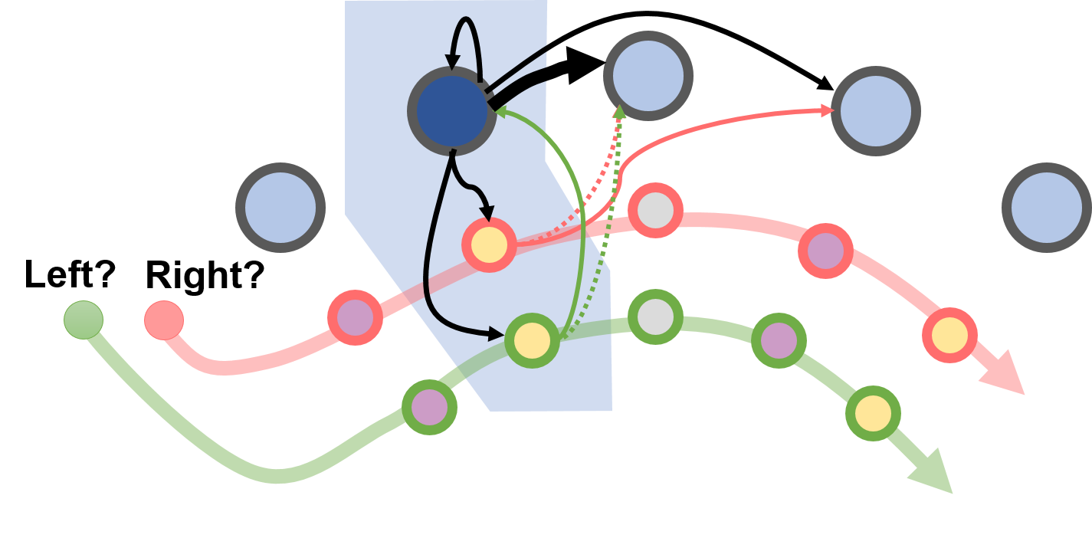
Update circuit is not obvious, but rather simple
Set of update pairs, one pushes ring forward by one step, one holds it back by one step
Need 3+M mod 3 pairs of neurons for each ring of size M
Two timesteps required
  One step to activate update neurons (if appropriate)
  One step to activate appropriate next ring neuron (advance 1 if no change)

Slide 18
Modular model is highly compact and inexpensive to update
1
2
3
4
0
Left?
Right?
1
2
3
4
0
1
2
3
4
5
6
0
1
2
3
4
5
6
7
8
9
10
0
1
2
3
4
5
6
0
II. Global Reference
I. Local Reference
1
2
3
4
5
6
7
8
9
10
0
Measure | Cost (for k locations; 1-D case)
Position memory per walker | O(k^(1/N)), where N is # rings of length s_{n}, s.t. Π_{N}(s_{n})>k
Connection memory per walker | Σ_{N} (9*s_{n}+2*(3+s_{n} mod 3))
Total neurons per walker | 2+Σ_{N} (s_{n}+2*(3+s_{n} mod 3))
Time per physical timestep | 2
Position energy per timestep | O(N)
Update energy per timestep | O(N)

Slide 19
Modular model is highly compact and inexpensive to update
1
2
3
4
0
Left?
Right?
1
2
3
4
0
1
2
3
4
5
6
0
1
2
3
4
5
6
7
8
9
10
0
1
2
3
4
5
6
0
II. Global Reference
I. Local Reference
1
2
3
4
5
6
7
8
9
10
0
Measure | k = 1000, 1D | k = 1000, 2D | k=10000, 1D
Modular set | {7, 11, 13} | {7, 11, 13} x2 | {17, 23, 29}
Position memory per walker | 1001 | 1002001 | 11339
Connection memory per walker | 293 | 583 | 639
Total neurons per walker | 59 | 118 | 101
Time per physical timestep | 2 | 2 | 2
Position energy per timestep | 3 | 6 | 3
Update energy per timestep | 3 | 3 | 3

Slide 20
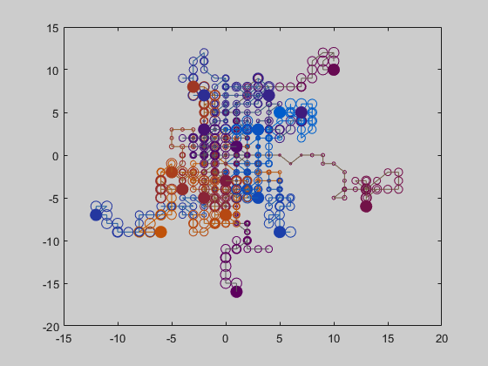
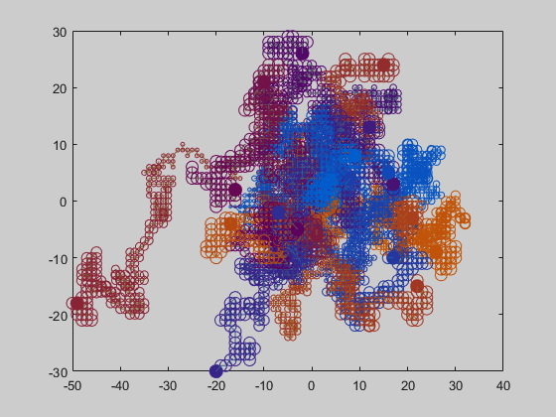
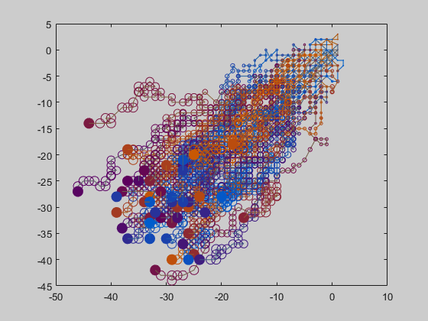
Neural random walkers evolve as expected

Slide 21
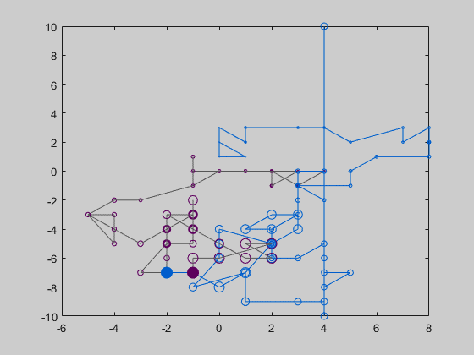
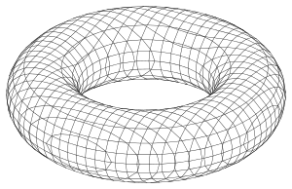
Spatial representation is actually a torus
Beyond capacity of code, overflows result in wrap-around behavior

Slide 22
If we are going to think about neuromorphic processors as an embarrassingly large parallel computer, can we model the mesh itself?

Slide 23
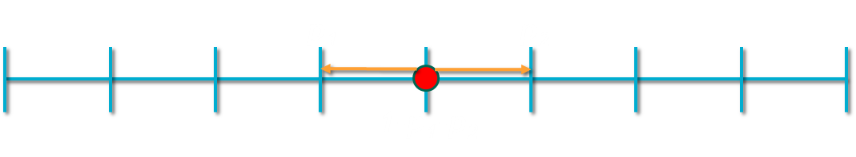
Tracking particles over space → tracking densities at each location
Instead of each particle owning a population of neurons representing the particle’s location…
…have each location own a population of neurons that represent the probability density of particles
p₁
p₂
ρ₋₁
ρ₀
ρ₁

Slide 24
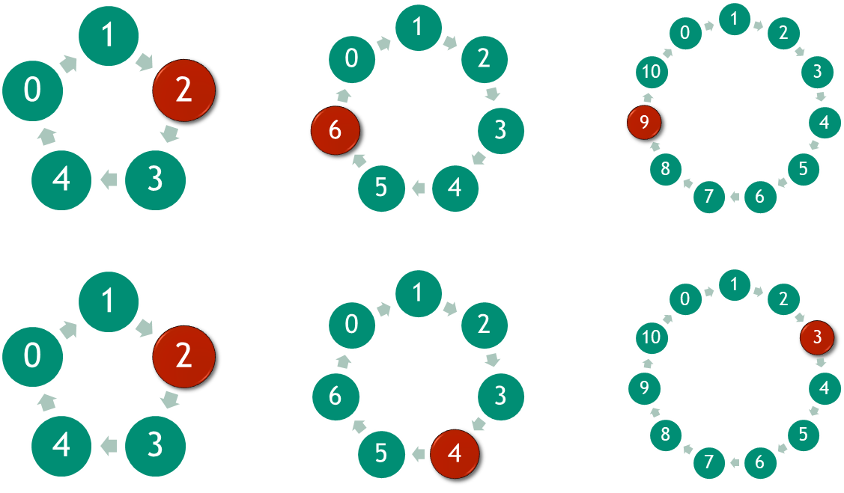
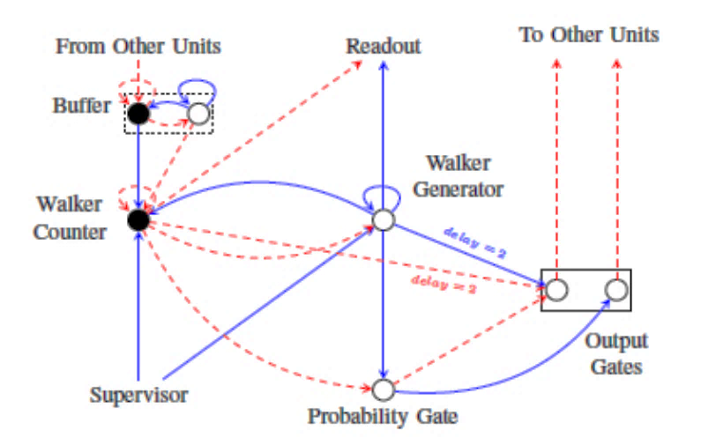
The Density and Particle methods are distinct implementations with different costs and benefits
Particle Method
Circuit per walker
Density Method
Circuit per position

Slide 25
Density model repeats basic circuit at every vertex of mesh
Each vertex encodes density of particles in the internal potential of certain nodes
Each time step “hands off” particles to connected vertices according to probabilistic maps
Measure | Cost (for k locations, simulating N walkers; 1-D case)
Walker memory | O(1)
Connection memory | O(k)
Total neurons | O(k)
Time per physical timestep | O(max(ρ_{i})), where ρ_{i} is the density of walkers at each location
Position energy per timestep | O(N)
Update energy per timestep | O(N)

Slide 26
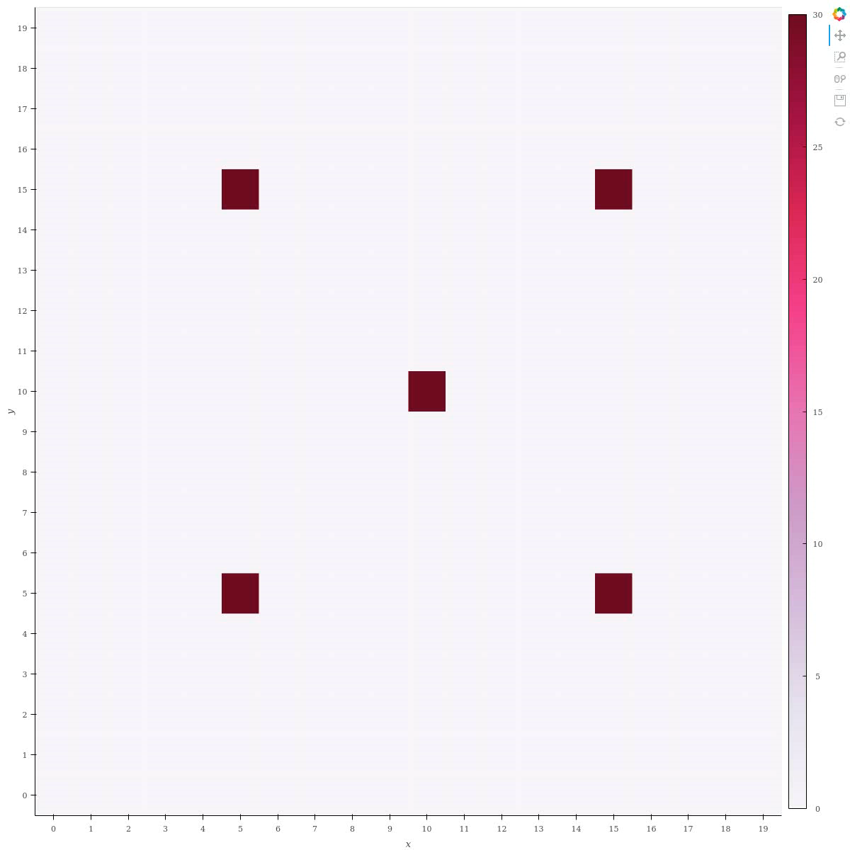
Density method over free space

Slide 27
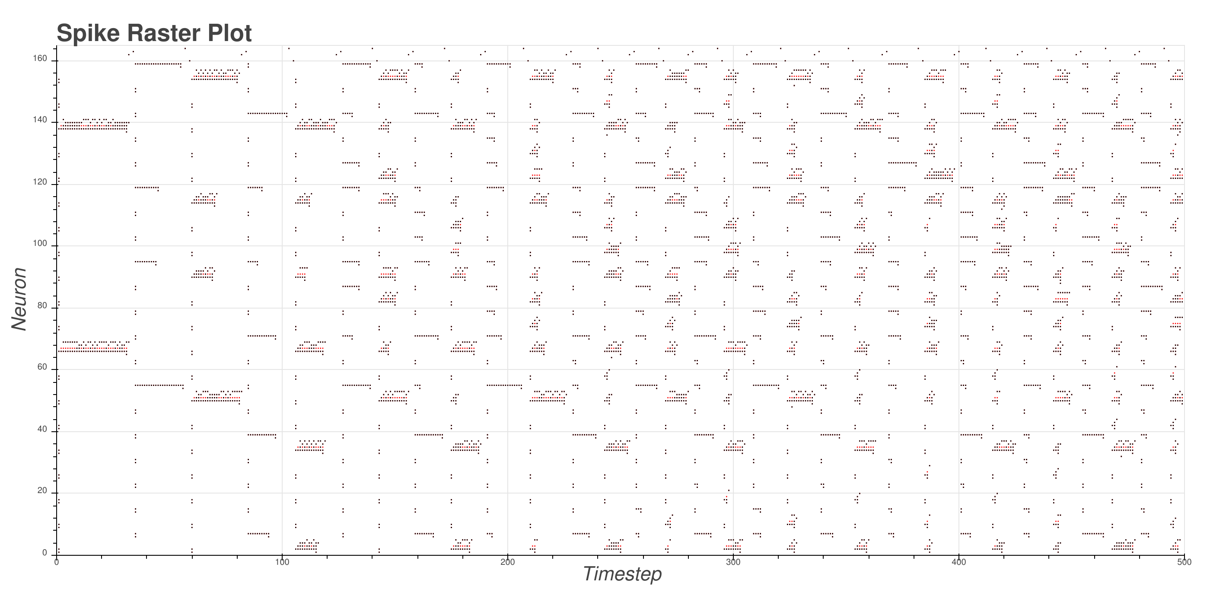
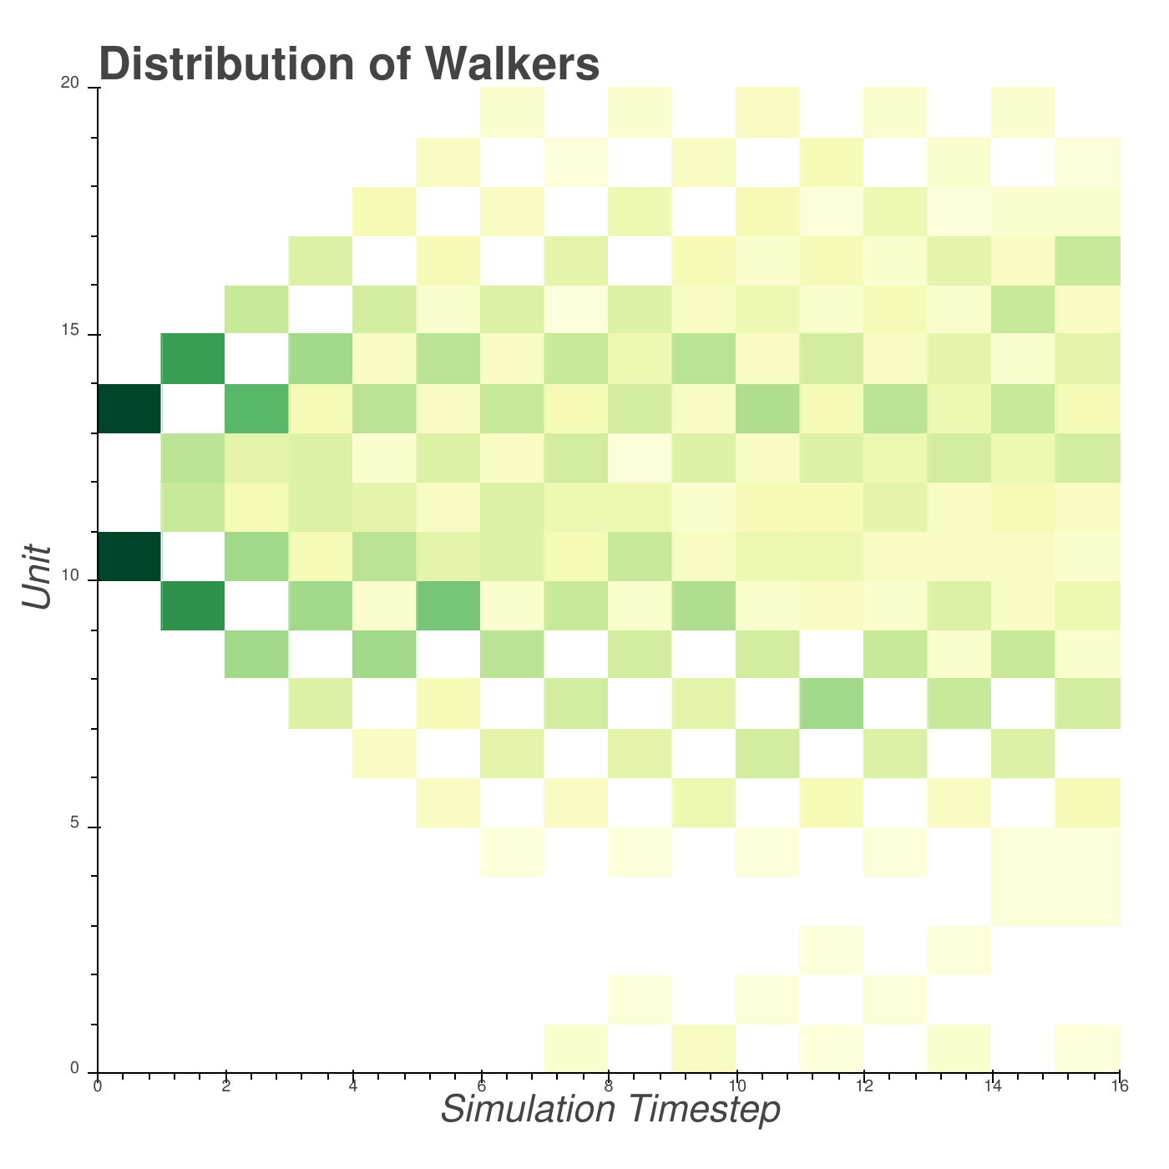
Speed of simulation depends on density distribution of walkers

Slide 28
Density method can easily handle boundary conditions

Slide 29
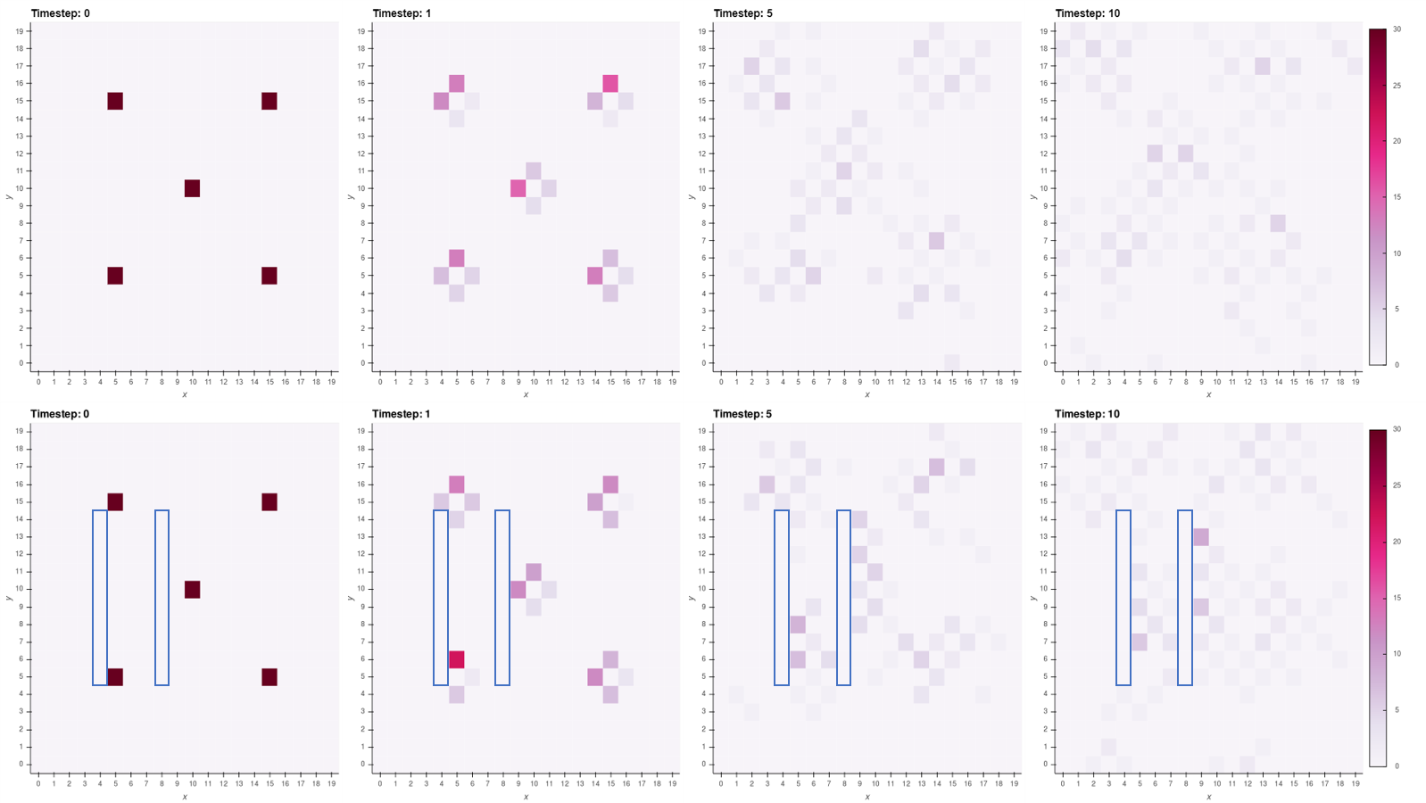
Density model is effective at looking at full distributions instantaneously

Slide 30
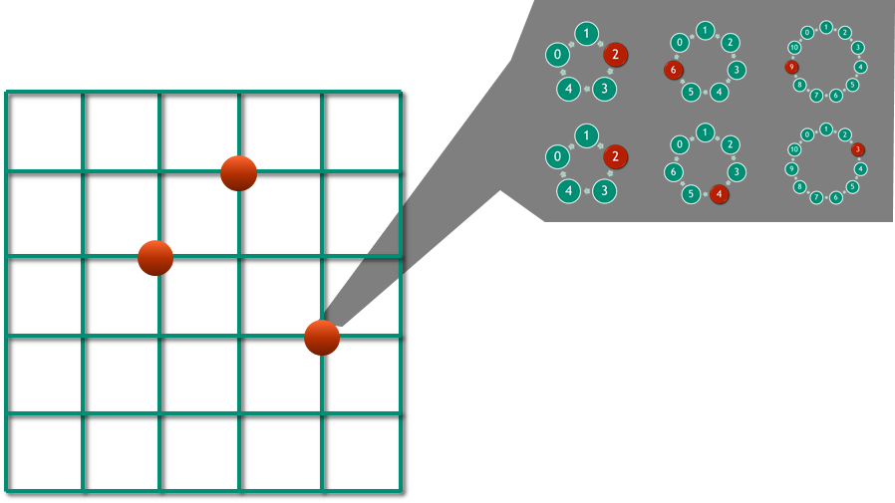
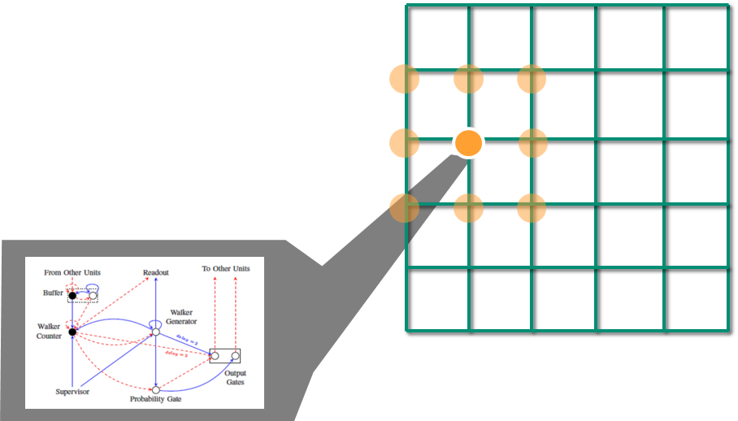
Advantages of each method
Particle method
  Path dependent behavior is readily available
  Communication is entirely local within particles (embarrassingly parallel)
  With unlimited neurons, can run in constant time
Density method
  Densities are readily available at all times
  Non-local or other complex graphs can easily be implemented
  With limited neurons, can tradeoff statistical approximation (i.e., number
  of walkers) with longer or shorter simulations

Slide 31
Conclusions
Spiking neural hardware is not only suitable - but advantageous - for random walk simulations
Neural algorithm for particles runs in constant time and is readily scalable on neuromorphic hardware
Density-based neural algorithm natively provides aggregate statistics instantaneously
Acknowledgements
William Severa, Ojas Parekh, Rich Lehoucq
Sandia LDRD program and DOE Advanced Simulation and Computing

