Slide 1
Leading the evolution of compute
Mike Mayberry CTO and Managing Director of Intel Labs

Slide 2
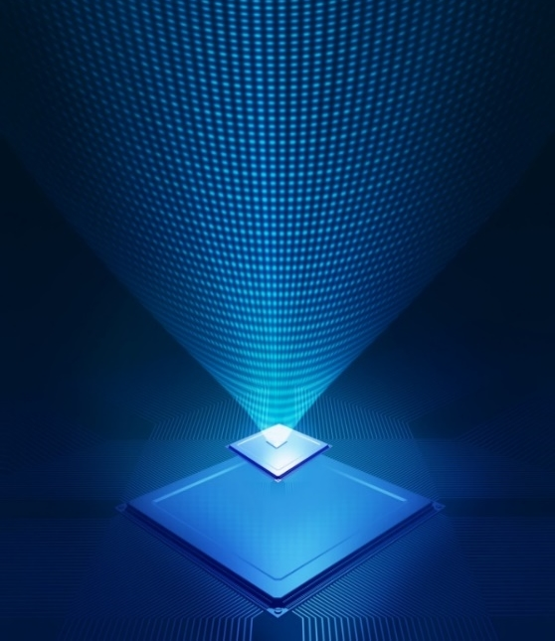
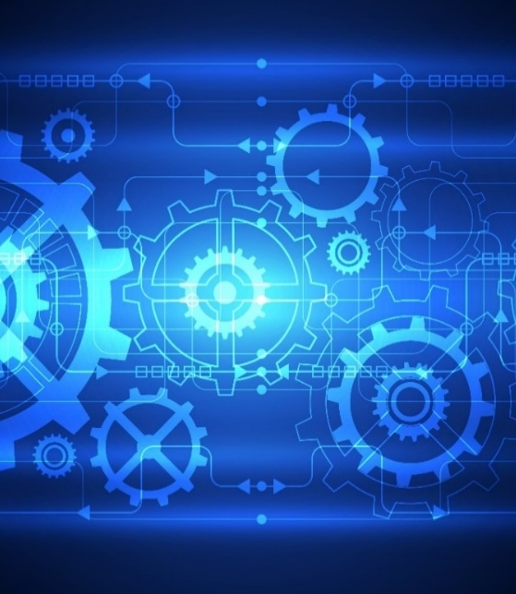
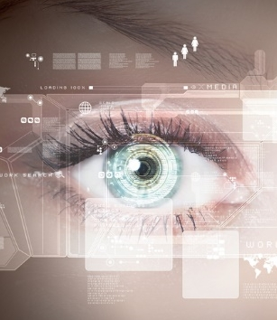
Intel’s Research Efforts
COMPONENTS RESEARCH
INTEL LABS
ENABLING MOORE’S LAW
DEVELOPING NOVEL INTEGRATION
ENABLING FUTURE PRODUCT CAPABILITIES
ANTICIPATING FUTURE INTEL
UNIVERSITY RESEARCH Expanding the Frontier, Future Intel Collaborators

Slide 3
You Are Here
“Any sufficiently advanced technology
is indistinguishable from magic” – Arthur C. Clarke 1973
FEW x 10⁹
100+ x 10⁹
~10²¹
2X Better
FEW Billion Logic Transistors per cm²
Few 100 Billion
Memory Bits per cm²
About a Sextillion
Shipped Worldwide per yr
Than the Previous Generation

Slide 4
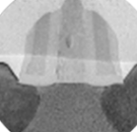
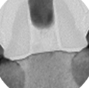
Leading Edge Process Technology
“The reports of my death are greatly exaggerated” – Mark Twain 1897
Strained Silicon
Hi-K Metal Gate
3D Transistors
90 nm
65 nm
45 nm
32 nm
22 nm
14 nm
10 nm
7 nm
5 nm

Slide 5
What should we build ?

Slide 6
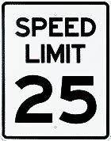
Multiple Possible Futures
Devices
Ambient
Cloud Computing
5

Slide 7
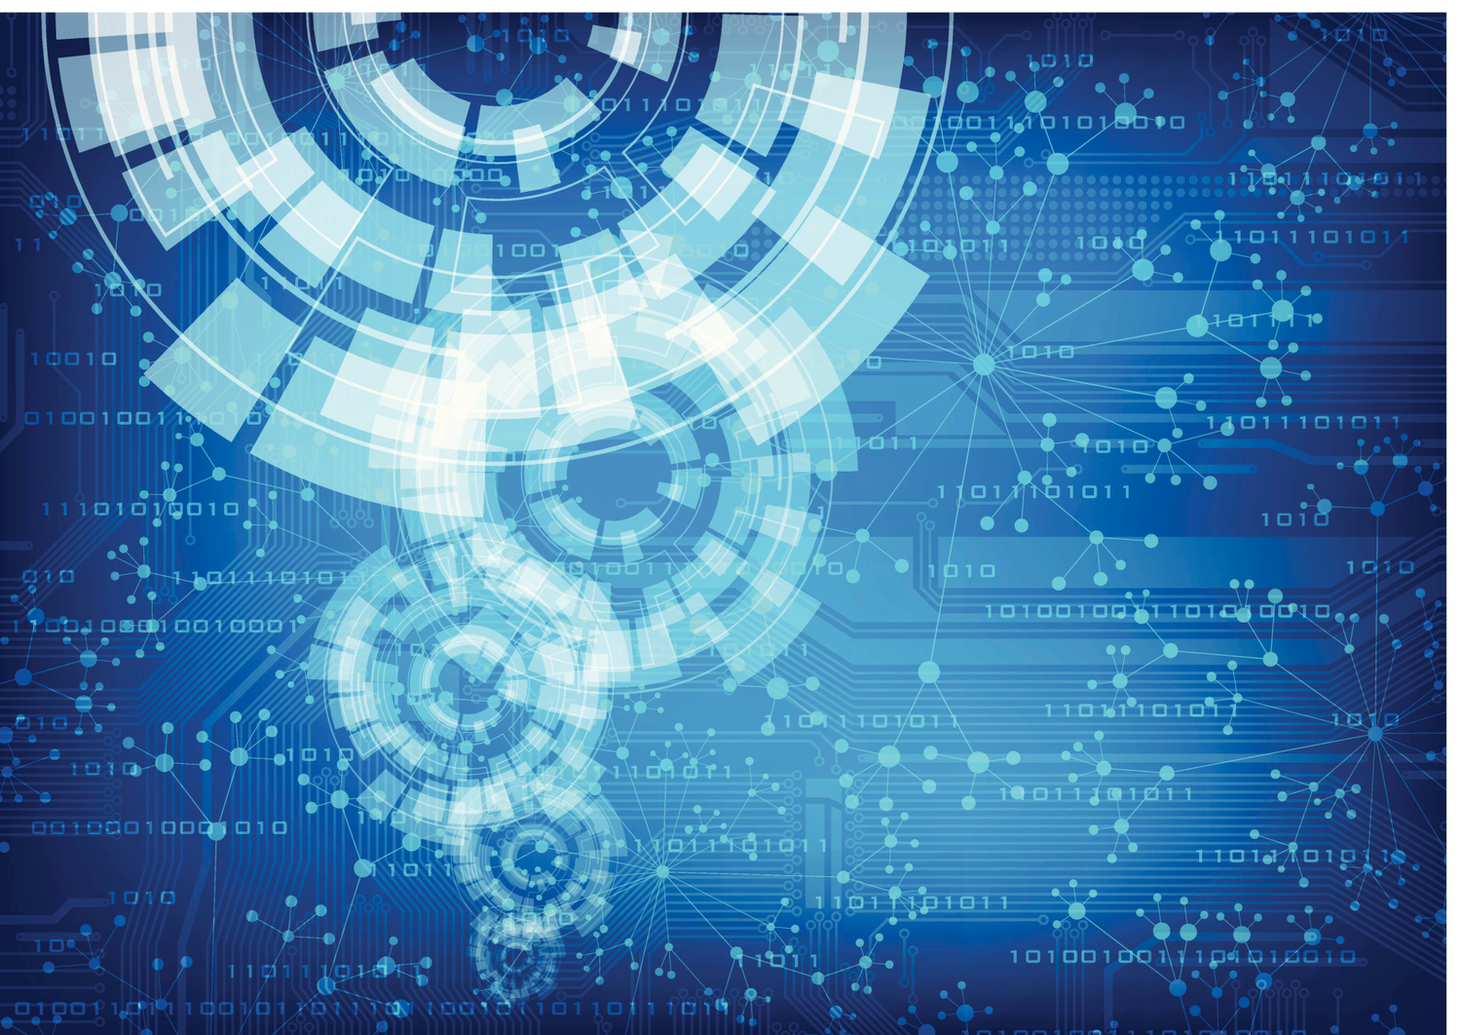
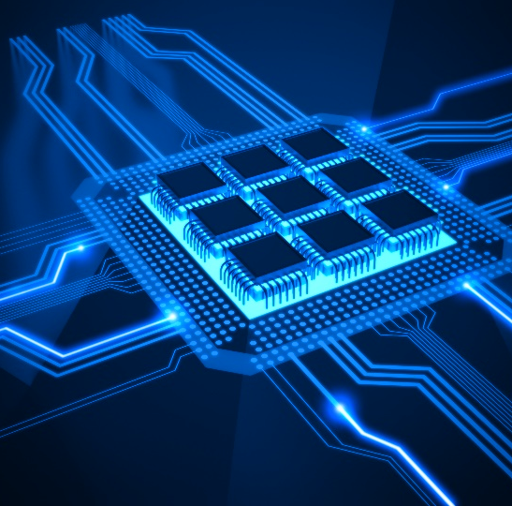
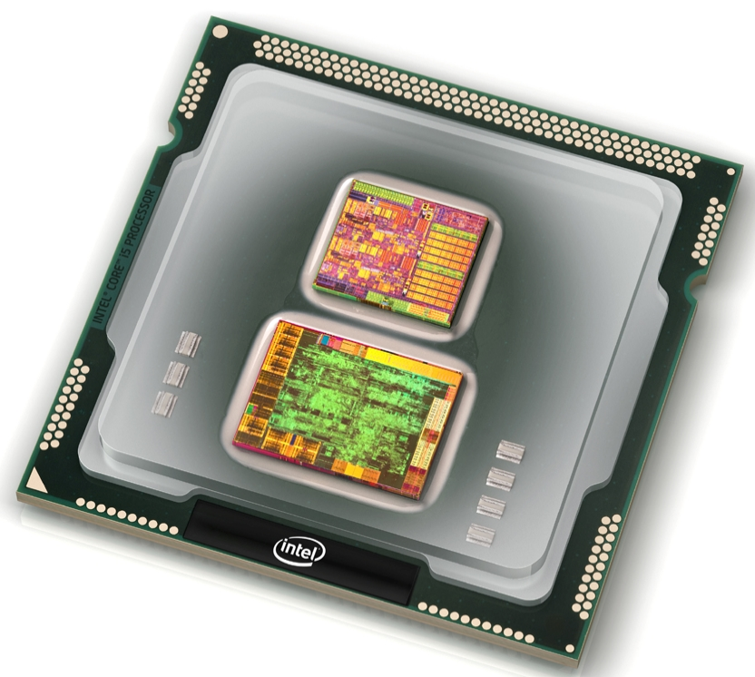
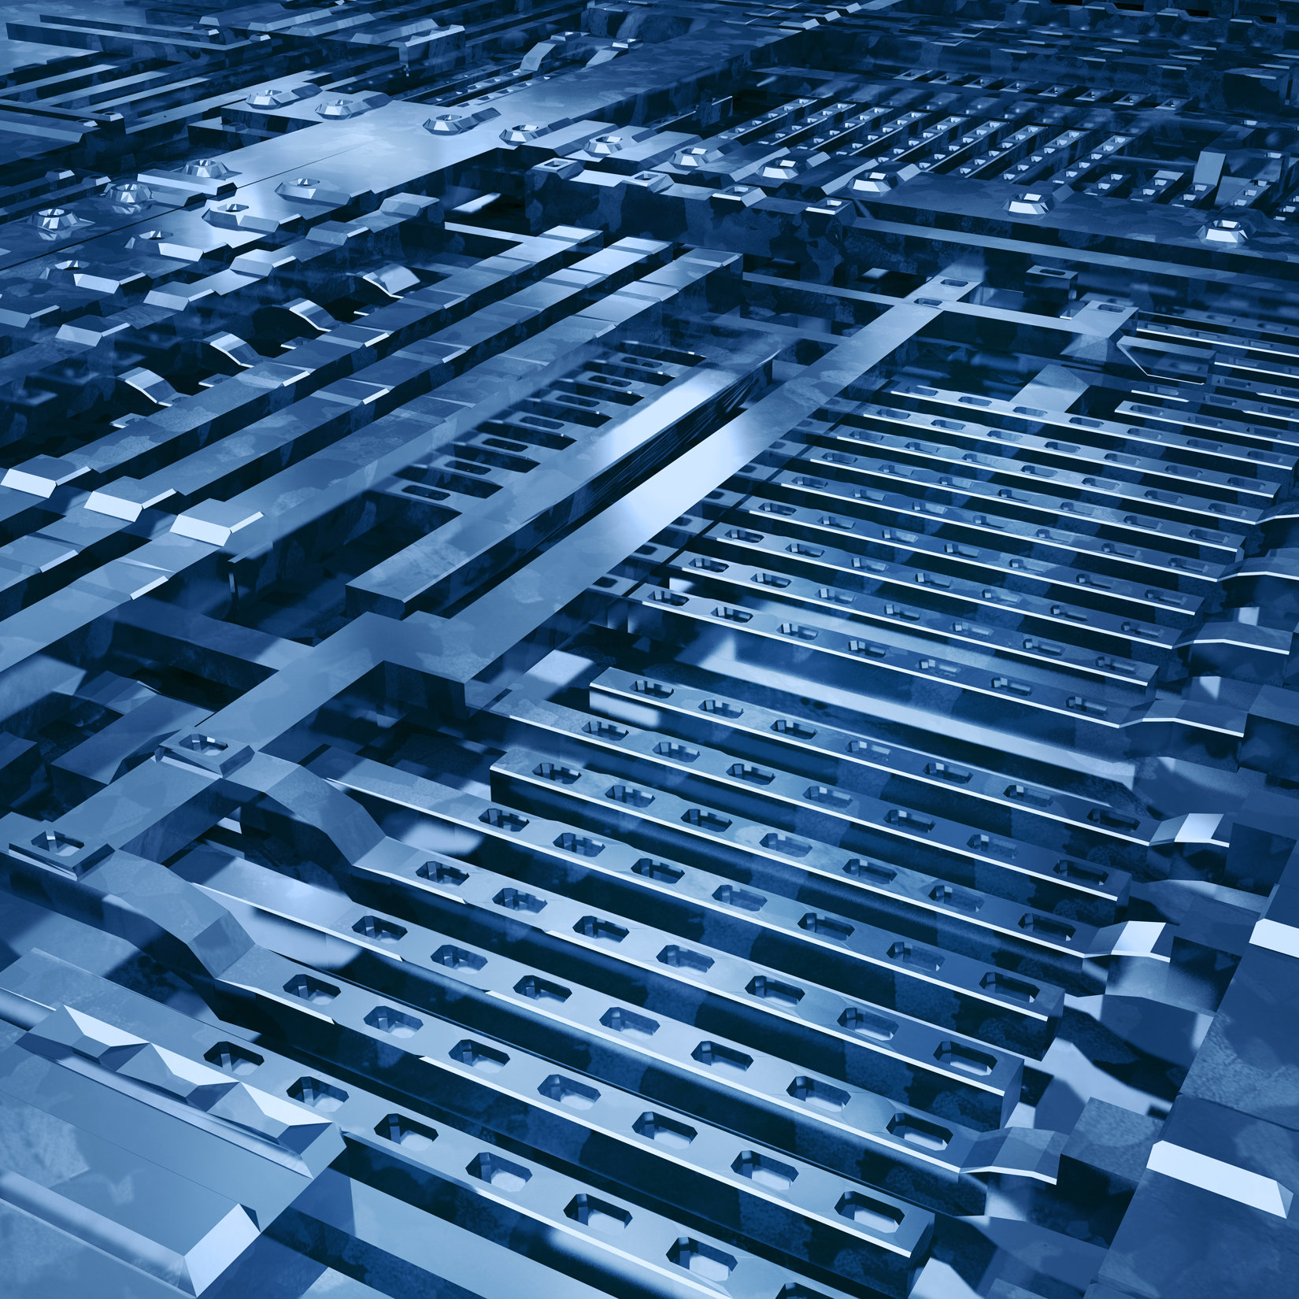
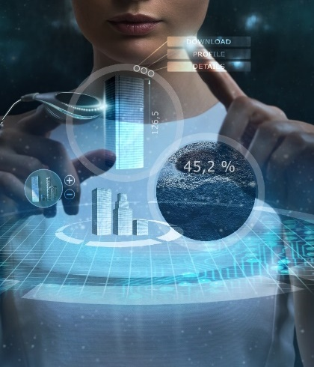
Intel Labs Research Agenda
Deliver breakthrough innovations to fuel Intel’s growth and technology leadership
Communication
Compute
Systems
Moore’s
Law
Security
Sensemaking
Novel Integration

Slide 8
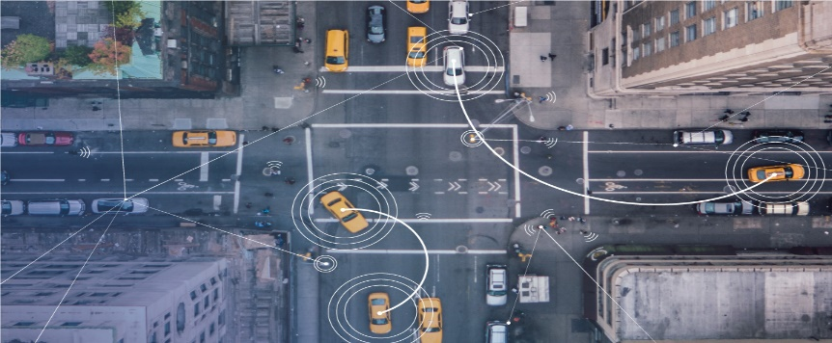
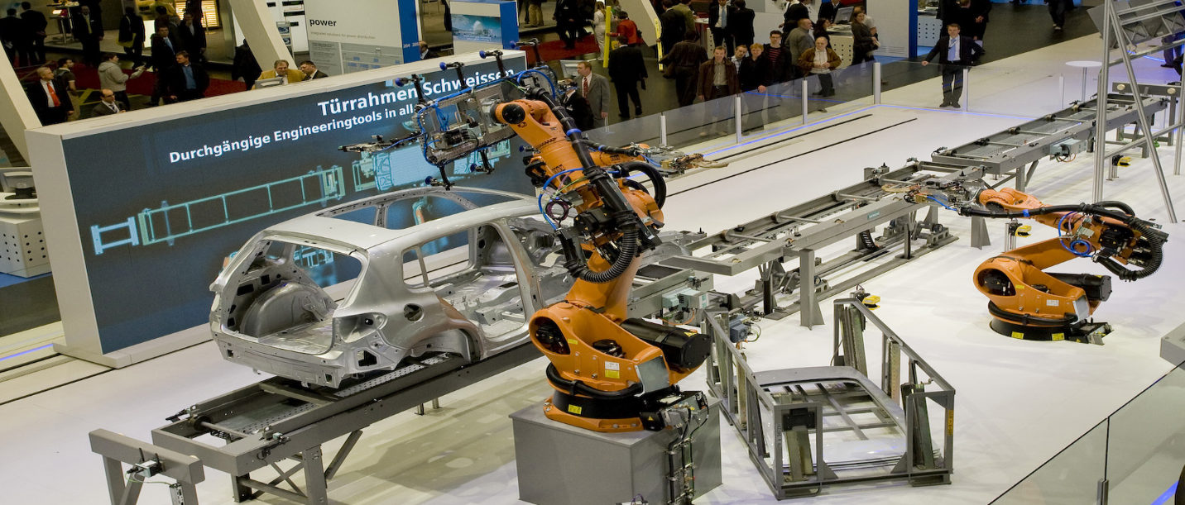
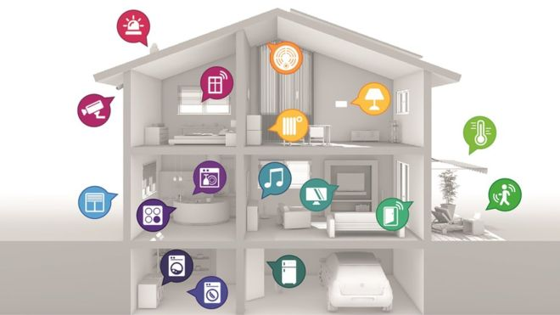
10’s of Billions Connected Devices
Autonomous Systems
Bandwidth and Density
Defining “i” of IOT
X2X Communication
Accurate positioning & mapping
Highly reliable connectivity link
Environmentally context aware
Distributed intelligence
Cooperative networking
IoT Systems
Intelligent Home Network

Slide 9
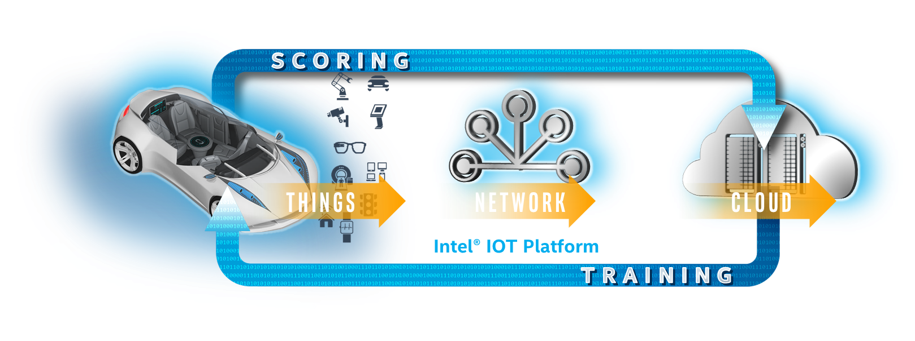
Autonomous Driving
Sense the environment
Communication
Security
Cameras
Radar
LiDAR
Vehicles
Infrastructure
Cloud
Platform
Communications
Analytics

Slide 10
Sensing and Sensemaking
Sensing & Inference
Discovering Triggers
Personalized Adaptation
Sensor Data Capture
Discover Correlations
Discover Routines
Inference Analytics
Put Data in Context
Context Aware
Recommendations
Context Capture
Generate Hypothesis
Continuous Learning

Slide 11
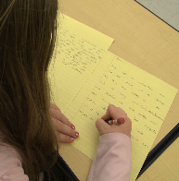
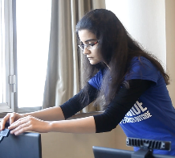
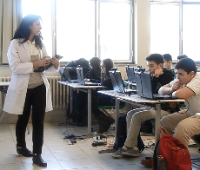
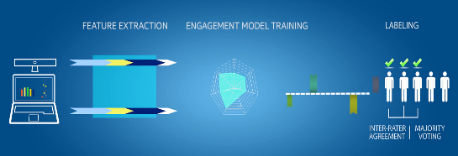
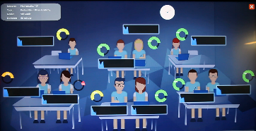
Adaptive Learning Research

Slide 12
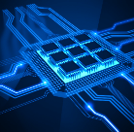
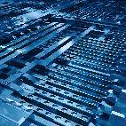
Intel Labs Research Agenda
Deliver breakthrough innovations to fuel Intel’s growth and technology leadership
Communication
Compute
Systems
Moore’s
Law
Security
Sensemaking
Novel Integration
Enabling Scalable, Energy Efficient Compute from Sensors to Servers

Slide 13
Artificial intelligence Evolution
Empirically Driven
Handling Ambiguity
Complex, Varied Data
Machine Learning
Natural Intelligence
Contextual Reasoning
High Accuracy on Sparse Data
Autonomous Learning

Slide 14
Emerging opportunities – Smart Computing
Bidirectional Information Passing (recognition + anticipation + retraining)
Specialized
Feature extraction
Neurons
Generalized
Feature extraction
Neurons
Hierarchical
Representations
In neural networks
Compressive sensing
Deep learning
Structure
Meaning
≠ Smart, Cognitive

Slide 15
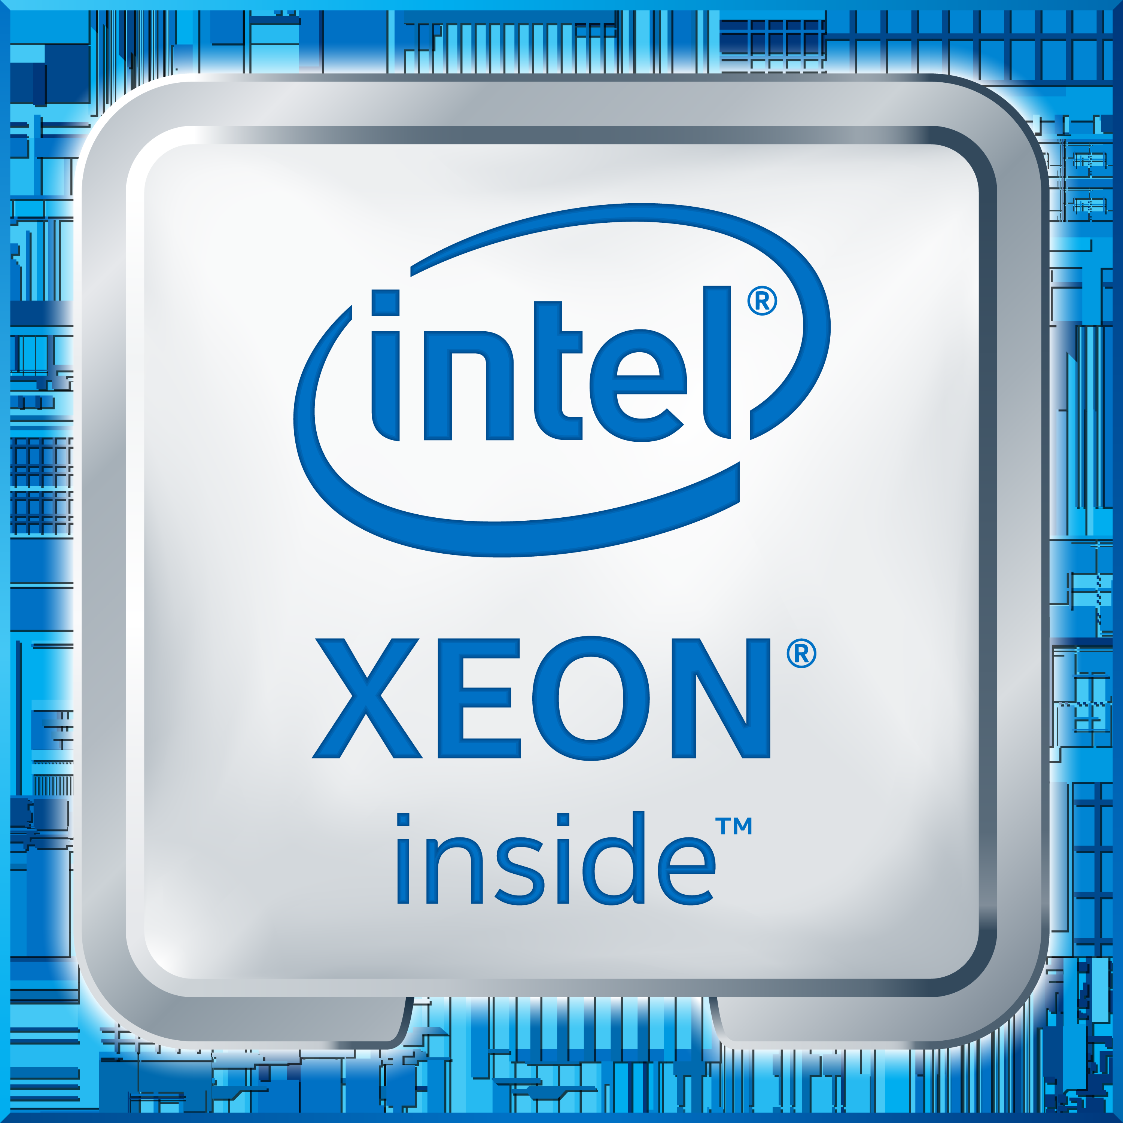
Reconfigurable Compute
Unlocking the power of
Heterogeneous Computing
AI algorithms are rapidly evolving and compute needs to evolve as well
Enabling new algorithms and workloads that perform best on Intel platforms with FPGA
Large-scale software frameworks are being developed and will drive the apps of tomorrow
Intel FPGAs

Slide 16
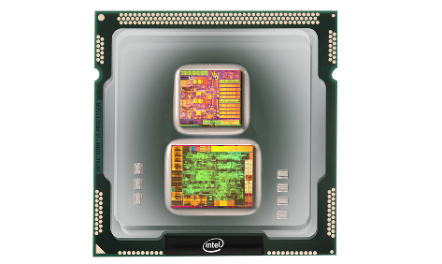
Neuromorphic Solves Hard Problems Efficiently Objective is to develop a programmable architecture delivering >100x energy efficiency over current computing architectures for these workloads
Integrated Memory + Compute Neuromorphic Architecture
Solving challenging problems
Sparse Coding
Dictionary Learning
Constraint Satisfaction
Pattern Matching
Dynamic Learning & Adaptation
…and beyond
Powered by Moore’s Law
Notes:
Intel is a hardware company now we are also in the forefront of algorithms, we are also looking at different architectures that might work better or natural in processing unstructured data thus building a platform that can be embedded in autonomous systems so that the system can do self-learning.
Our current test chip project has the overall research goal to achieve a 100X improvement in performance, energy efficiency, area efficiency & robustness for visual, speech/language & multi-mode sensor cognition, inference, and analytics. Unlike the prevalent artificial neural network (ANN), neuromorphic computing is based on spiking neural network that claims to be modeling how neurosynaptic system actually works.
Applications for NmC
By enabling autonomous computing for a low energy cost, neuromorphic computing hardware could play a big rule in the future of large scale data centers and exoscale computing systems. The energy efficient neuromorphic hardware will also create a whole new set of applications from intelligent mobile device to intelligent and efficient IOT devices and systems; further more, since these systems can learn online, they can enable these devices to operation in a self-organized fashion without any manual intervention. One example could be a camera that can learn from the pictures it captures and labels the pictures when similar objects appear in future images.

Slide 17
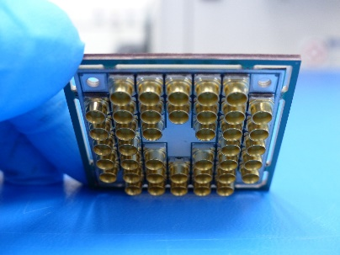
TRANSFORMATIONAL RESEARCH – Quantum Computing
Material science & ML algorithms
Microarchitecture and algo co-design
Post-quantum secure cryptography
Intel and QuTech addressing critical challenges
Make Better Qubits
Improve Qubit Connectivity
Develop a scalable I/O
Innovative design, fabrication and packaging of 7, 17, 49 Qubits
Cryogenic CMOS control IC
Algorithms and system architecture
…and beyond
Powered by Moore’s Law
Notes:
We decided to join physicist inventing quantum computing and we are engaged in a multi-year collaboration with Delft University and QU Tech (Netherlands) and our current focus is to improve the way qubits are fabricated, we are working on better connectivity I/O qubits and we are working in developing new quantum algorithms and building up a complete Quantum System.
We are just witnessing the dawn of a new class of computing and we believe it will take our combined knowledge and the right mix of cross-discipline collaborators to usher this promising technology into our every day life.

Slide 18
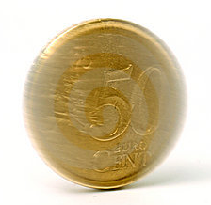
Thinking Differently
Conventional
Known procedures
Generate answers
Deep learning
Known answers
Generate procedures with training
Neuromorphic
Many procedures
Adapt the answer with reinforcement
Quantum
Answers superimposed
Select and measure the answer
21

Slide 19
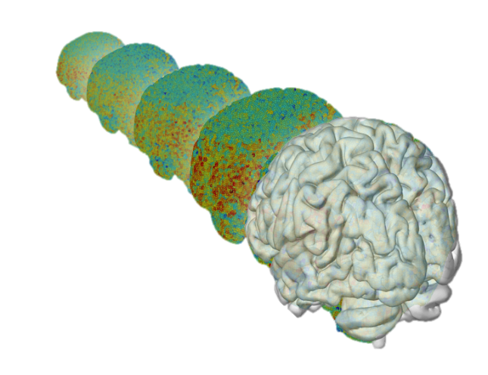
Brain Decoding
metabolic brain
Unlocking the mind with computational neuroscience in collaboration with Princeton
Capturing the complexities of the brain that current circuits do not
Providing some key theories missing from whole brain simulation
Using Functional MRI to study attention, control, and decision making
anatomical brain
Time
3D brain activity generated by fMRI
22

Slide 20
Summary
We live in magical times because we can implement what people have imagined
Working together across disciplines will be greater than sum of parts
Join with us in creating the future

Slide 21
You Are Here
“Any sufficiently advanced technology
is indistinguishable from magic” – Arthur C. Clarke 1973

Slide 22
Legal Information
This presentation contains the general insights and opinions of Intel Corporation (“Intel”). The information in this presentation is provided for information only and is not to be relied upon for any other purpose than educational. Statements in this document that refer to Intel’s plans and expectations for the quarter, the year, and the future, are forward-looking statements that involve a number of risks and uncertainties. A detailed discussion of the factors that could affect Intel’s results and plans is included in Intel’s SEC filings, including the annual report on Form 10-K.
Any forecasts of goods and services needed for Intel’s operations are provided for discussion purposes only. Intel will have no liability to make any purchase in connection with forecasts published in this document. Intel accepts no duty to update this presentation based on more current information. Intel is not liable for any damages, direct or indirect, consequential or otherwise, that may arise, directly or indirectly, from the use or misuse of the information in this presentation. Intel technologies’ features and benefits depend on system configuration and may require enabled hardware, software or service activation. Learn more at intel.com, or from the OEM or retailer.
Copyright © 2018 Intel Corporation.
Intel, the Intel logo, Xeon and Stratix are trademarks of Intel Corporation in the U.S. and/or other countries.
*Other names and brands may be claimed as the property of others

Slide 23
What Can We Invent With You?

